Slide 1


Human Resources
Dashboard project

Slide 2

Introduction
Goal
Variables and measures description
Questions
Analysis
Team members

Slide 3
Introduction
- This human resources data provides valuable insights into an organization's workforce and help HR managers make informed decisions about recruitment, retention, and separation.
-This project depends on Using Power Pivot to handle, analyse large volumes of data, and perform complex calculations.

Slide 4
Primary goal
“Analyze data related to Separation Reason to identify patterns and take measures to reduce turnover.”

Slide 5
Variables
Variable name | Type |  | Description
Business unit | Quantitative | continuous | The departments
Region | Qualitative | nominal | Regions of business units
Work-type | Qualitative | nominal | full-time or part-time
Pay-type | Qualitative | nominal | payment whether it’s hourly or by salary.
Separation Reason | Qualitative | nominal | The cause of employee turnover whether it’s voluntary or involuntary
Employee ID | Qualitative | nominal | Employee ID
Gender | Qualitative | nominal | Employees gender
Age | Quantitative | continuous | Employees Age
Ethnicity | Qualitative | nominal | Employees Ethnicity
Hire Date | Quantitative | continuous | The date of which an employee is hired
Bad hires | Qualitative | Binary | Bad hired employees in a specific period

Slide 6
Cont. Variables and measures:
Variable name | Type |  | Description
Tenure days or months | Qualitative | nominal | An employee's service period for any specific employer.
Age Group | Qualitative | nominal | The group classification for each employee (<30, 30<49, >50)
Date | Quantitative | continuous | Time line (Date)
Measure | Function | Description
Actives | CALCULATE([EmpCount], FILTER(Employee, Employee[Gender])) | Employees currently working in the company
Seps | CALCULATE(COUNT([EmplID]), FILTER(Employee, NOT(ISBLANK(Employee[TermDate])))) | Employees left the company
New hires | =SUM([isNewHire]) | employees who haven’t completed 1 month in the organization.
Average tenure days | =AVERAGE([TenureDays]) | The average service days for an employer.

Slide 7
Analytical Questions

Slide 8
Types of Questions
Descriptive
Exploratory
Predictive
Casual
Inferential
1
2
3
4
5

Slide 9



Asking descriptive questions ?
1- What is the total active and separated employees?
4- What is the average employees age for full time and part-time?
2- Number of employees working per hour or salary?
5- Number of employees in each region?
6- What is the percentage of voluntary and unvoluntary for each gender?
3- What is the most common Separation reason for each Gender?
7- What is the region with the maximum hired and that of maximum separated employees?

Slide 10

1- What is the total active and separated employees?

Slide 11
2- Number of employees working per hour or salary?
Row Labels | Count of PayTypeID
Hourly | 1127691
Salaried | 162568
Grand Total | 1290259

Slide 12
3- What is the most common Separation reason for each Gender?
Count of Term Reason | Column Labels
Row Labels | Involuntary | Voluntary | Grand Total
Male | 3501 | 11373 | 14874
Female | 3893 | 10675 | 14568
Grand Total | 7394 | 22048 | 29442
Count of Term Reason | Column Labels

Slide 13
4- What is the average employees age for full time and part-time?
work time type | Average of Age
Full-Time | 43.79380061
Part-Time | 35.38892361
Grand Total | 39.50014842

Slide 14
5- Number of employees in each region?
Row Labels | Count of EmplID
North | 222638
Midwest | 219885
Northwest | 204338
East | 143691
Central | 196283
South | 209858
West | 93566
Grand Total | 1290259

Slide 15

6- What is the percentage of voluntary and unvoluntary for each gender?
Count of Term Reason | Column Labels
Row Labels | Involuntary | Voluntary | Grand Total
Male | 11.89% | 38.63% | 50.52%
Female | 13.22% | 36.26% | 49.48%
Grand Total | 25.11% | 74.89% | 100.00%

Slide 16
7- What is the region with the maximum hired and that of maximum separated employees?
region | Count of Hire | separated region
North | 222638 | 4,959
Midwest | 219885 | 4,220
Northwest | 204338 | 5,775
East | 143691 | 2,257
Central | 196283 | 4,710
South | 209858 | 4,934
West | 93566 | 2,587
Grand Total | 1290259 | 29,442

Slide 17
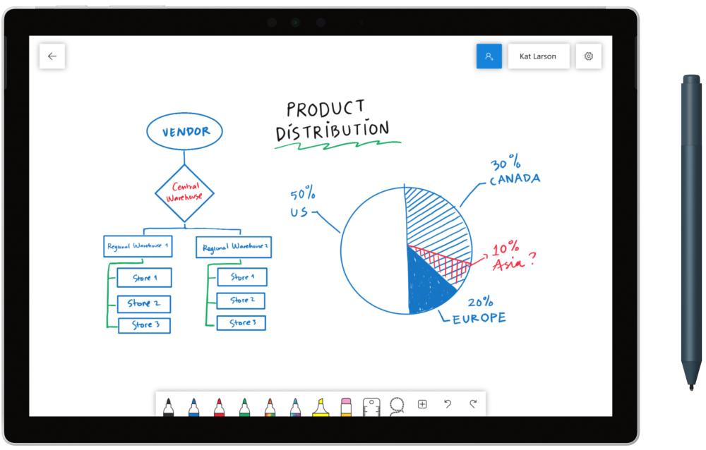
Asking exploratory question?
1- What is the relation between ethnicity and region?
3- Is there a relation between age group and bad hires?
2- What is the relation between separation-reason and region?
4-Is there a correlation between bad hires and sep-reason?

Slide 18
1- What is the relation between ethnicity and region?
value of the ethnicity | ethnicity
region | Group A | Group B | Group C | Group D | Group E | Group F | Group G
North | 193643 | 14553 | 6587 | 2663 | 1297 | 3803 | 92
Midwest | 191102 | 14169 | 8380 | 3455 | 846 | 1869 | 64
Northwest | 171444 | 20526 | 3010 | 5826 | 425 | 2830 | 277
East | 115732 | 13947 | 6361 | 3666 | 508 | 3344 | 133
Central | 162415 | 19618 | 7413 | 3531 | 951 | 2104 | 251
South | 162120 | 33380 | 5051 | 5228 | 886 | 3003 | 190
West | 63150 | 12038 | 8810 | 5443 | 311 | 3663 | 151
dark blue refers to the strongest relationship between the two variables
blue refers to moderate relationship between the two variables
the last color refers to weak relationship between the two variables

Slide 19
2- What is the relation between separation reason and region?
Count of Term Reason | Column Labels
Row Labels | Involuntary | Voluntary
North | 956 | 4003
Midwest | 802 | 3418
Northwest | 1447 | 4328
East | 802 | 1455
Central | 1062 | 3648
South | 1447 | 3487
West | 878 | 1709
dark blue refers to the strongest relationship between the two variables
blue refers to moderate relationship between the two variables
the last color refers to weak relationship between the two variables

Slide 20
3- Is there a relation between age group and bad hires?
Count of Age | Column Labels
Row Labels | not bad hire | bad hire
<30 | 456991 | 7058
30-49 | 421399 | 1900
50+ | 402031 | 880
dark blue refers to the strongest relationship between the two variables
blue refers to moderate relationship between the two variables
dark blue refers to the strongest relationship between the two variables

Slide 21
4-Is there a correlation between bad hires and sep-reason?
Count of Term Reason | Column Labels
Row Labels | not bad hire | bad hire
Involuntary | 5106 | 2288
Voluntary | 14498 | 7550
dark blue refers to the strongest relationship between the two variables
blue refers to moderate relationship between the two variables
dark blue refers to the strongest relationship between the two variables

Slide 22
Asking Predictive questions ?
1- Can we predict the separation reason of employees for the next 4 months?
3- Can we predict the percentage of voluntary employees for the next 2 year?
2- Can we predict the percentage of bad hires for the next year?

Slide 23
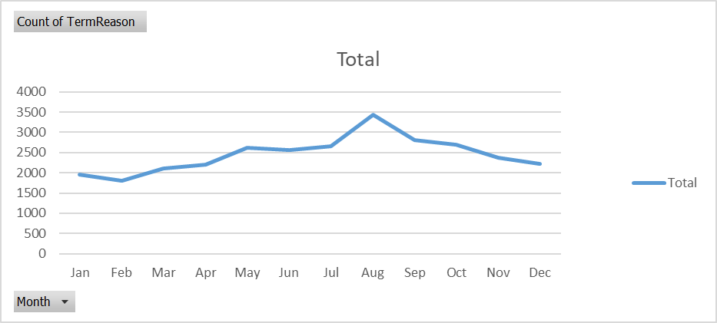
1- Can we predict the separation reason of employees for the next 4 months?
months | Count of TermReason
Jan | 1961
Feb | 1798
Mar | 2105
Apr | 2196
May | 2628
Jun | 2561
Jul | 2664
Aug | 3437
Sep | 2801
Oct | 2691
Nov | 2379
Dec | 2221
Grand Total | 29442
The prediction of separation reason for the next 4 months is polynomial decreasing

Slide 24
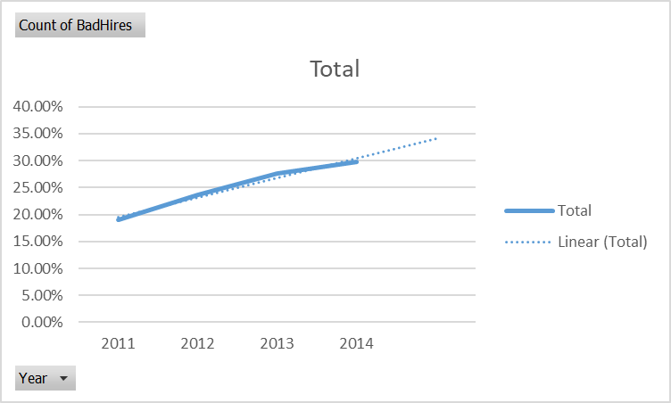
2- Can we predict the percentage of bad hires for the next year?
The prediction of the percentage of bad hires for the next year is linearly increasing
Row Labels | Count of BadHires
2011 | 19.00%
2012 | 23.65%
2013 | 27.57%
2014 | 29.79%
Grand Total | 100.00%

Slide 25
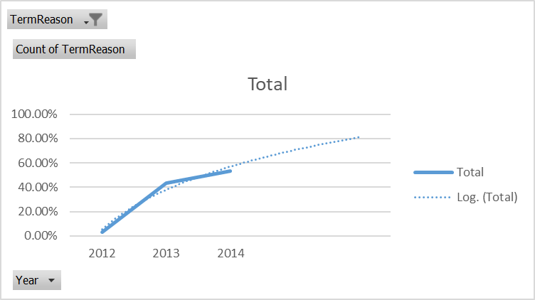
3- Can we predict the percentage of voluntary employees for the next 2 year?
The prediction of the percentage of voluntary employees for the next 2 year is logarithmic increasing
TermReason | V
Row Labels | Count of TermReason
2012 | 3.13%
2013 | 43.40%
2014 | 53.47%
Grand Total | 100.00%

Slide 26
Asking Inferential questions ?
1- What is the difference of separation reason with Tenure-months?
3- Is there an association between age and work-type (FP)?
2- What is the relation between separation-reason and Gender?

Slide 27
1- What is the difference of separation reason with Tenure-months?
Null hypothesis: 𝜇1 −𝜇2 = 0
Alternative hypothesis: 𝜇1 −𝜇2 ≠ 0
t-Test: Two-Sample Assuming Equal Variances
 | Tenure U | Tenure V
Mean | 17.98025 | 21.72483
Variance | 1903.425 | 3569.755
Observations | 7394 | 22048
Pooled Variance | 3151.304
Hypothesized Mean Difference | 0
df | 29440
t Stat | -4.96361
P(T<=t) one-tail | 3.48E-07
t Critical one-tail | 1.644905
P(T<=t) two-tail | 6.96E-07
t Critical two-tail | 1.960045
Since: t-crit two-tail > t-stat
Therefore: accept null hypothesis
Therefore: there is no difference between the means of the separation reason and tenure months variables

Slide 28
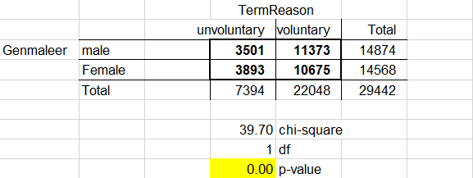
2- What is the relation between separation-reason and Gender?
Null hypothesis :gender is independent from separation reason
Alternative hypothesis: gender is dependent from separation reason
Crosstabulation
p-value < significance level
we reject null hypothesis
Gender is dependent from separation reason

Slide 29
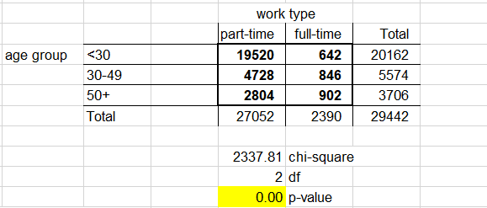
3- Is there an association between age and work-type (FP)?
Null hypothesis :age group is independent from work type
Alternative hypothesis: age group is dependent from work type
Crosstabulation
p-value < significance level
we reject null hypothesis

Slide 30
Asking Causal questions ?
1- being not a bad hire and affect separation reason?
2- Does the region factor affect the number of separated employees?

Slide 31
1- being not a bad hire and affect separation reason?
Count of BadHires | bad hires
seperation reason | not a bad hire | bad hire | Grand Total
Involuntary | 17.34% | 7.77% | 25.11%
Voluntary | 49.24% | 25.64% | 74.89%
Grand Total | 66.59% | 33.41% | 100.00%

Slide 32
1- being not a bad hire and affect separation reason?
The probability of being voluntary separation given that being not a bad hire: 0.73945
The probability of being voluntary separation given that being bad hire: 0.767435
The probability of being involuntary given that being not: 0.260399
The probability of being involuntary given that being bad hire: 0.23047

Slide 33
2- Does the gender factor affect the number of separated employees?
Count of TermReason | Gender
seoeration reason | Male | Female | Grand Total
Involuntary | 11.89% | 13.22% | 25.11%
Voluntary | 38.63% | 36.26% | 74.89%
Grand Total | 50.52% | 49.48% | 100.00%

Slide 34
2- Does the gender factor affect the number of separated employees?
The probability of being voluntary separation given that being male: 0.764648
The probability of being voluntary separation given that being female: 0.732821
The probability of being involuntary separation given that being male: 0.235352
The probability of being involuntary separation given that being female: 0.267179

Slide 35
Our team
Ganna Allah Asaad
Toka alsayed
204115
214091
Mariem mohamed ibrahem
Wesam mohamed
214123
214100

Slide 36


“
”
Instructor: Dr. Rowaida Ali E-mail: rowaida-ali@eru.edu.eg
Teaching Assistant: Amer Ibrahim
E-mail: amer-ibrahim@eru.edu.eg

